Slide 1






Architectural
Ledger
Vendor Management System Portal
Java Application
•
RAG Pipeline
•
Qwen:0.5B (Ollama)
•
Pinecone
•
nomic-embed-text
☕
🤖
📐
Pure Java Application
Qwen:0.5B Ollama LLM
nomic-embed-text
🗄️
⚖️
🐘
Pinecone Vector DB
Contract Compare
PostgreSQL Database
Team: Atharva Abhijeet Mahalkar| Japkeerat Kaur | Prakhar Vishwakarma · Guide: Prof. Suhas Joshi · April 2026

Slide 2


Catalog
Architectural Ledger: Vendor Management System Portal
01
1. Problem Statement
06
6. Application Screenshots
02
2. System Architecture (100% Java)
07
7. Use Cases
03
3. RAG Pipeline Implementation
08
8. Challenges & Solutions
04
4. Tools & Technologies
09
9. Future Scope
05
5. Project Modules
10
10. Conclusion
Team: Atharva Abhijeet Mahalkar| Japkeerat Kaur | Prakhar Vishwakarma · Guide: Prof. Suhas Joshi · April 2026
02

Slide 3
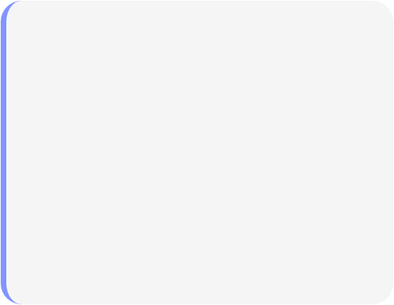



Problem Statement
Identifying Core Business and Technical Challenges
01
Business Problem
02
Technical Problem
Vendor contracts scattered — no central searchable store
Keyword search fails on semantic meaning
No vector DB for similarity-based document retrieval
Extracting specific clauses requires reading full documents
No LLM to generate grounded answers from docs
No automated contract comparison for risk assessment
Cloud AI APIs = privacy risk + billing cost
Compliance checks done manually — slow and error-prone
Team: Atharva Abhijeet Mahalkar| Japkeerat Kaur | Prakhar Vishwakarma · Guide: Prof. Suhas Joshi · April 2026
03

Slide 4

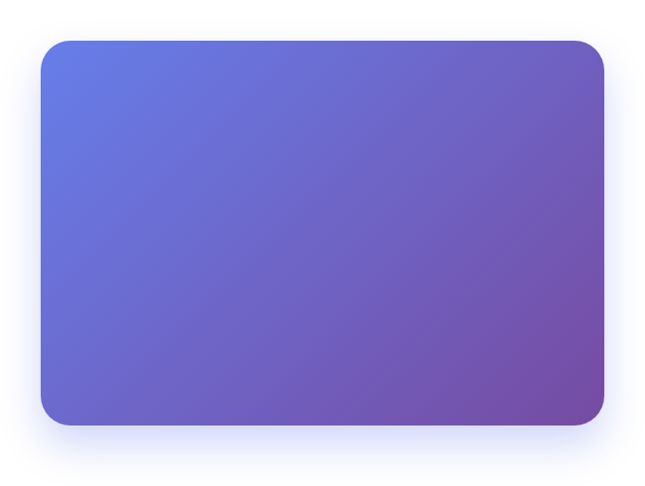
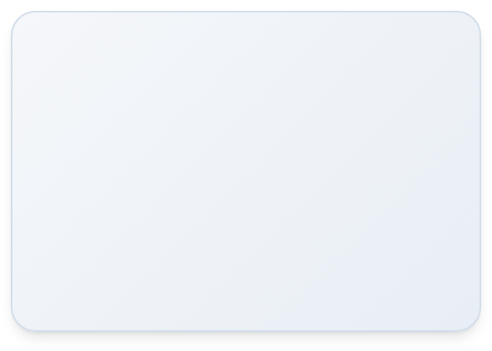




Beyond Keyword Search: From Finding to Understanding
The Old Way
The New Way
The "Ctrl + F" Approach
Our AI-Powered VMS
Exact Match Only: Finds a word, but not the meaning.
Semantic Understanding: Finds "Payment Terms" even if the document says "Remittance Schedule."
Manual Sifting: You find 20 instances of "Payment," but you still have to read all 20 to find the actual terms.
Instant Answers: Doesn't give you a list of pages; it gives you a concise, accurate answer.
Fragmented View: Can only search one document at a time.
Zero Context: It tells you where a word is, but not what it means in the bigger picture.
Cross-Document Intelligence: Analyzes contracts, invoices, and logs simultaneously.
Contextual Synthesis: Compares two different vendors or documents automatically.
The Result: Information Retrieval
The Result: Knowledge Extraction
Ctrl + F finds the needle in the haystack. Our project explains what the needle is doing.

Slide 5
System Architecture 100% Java
Multi-layered Architecture for Secure and Scalable Vendor Management
FRONTEND (HTML / CSS / JS)
Static files served by Java HTTP Server — all 6 portal pages
JAVA APPLICATION LAYER
Routing, Vendor CRUD (PostgreSQL/JDBC), AI orchestration
JAVA AI SERVICES
IngestService · SearchService · CompareService (HTTP to Ollama & Pinecone)
OLLAMA (localhost:11434)
Serves Qwen:0.5B (generate) + nomic-embed-text (embeddings) locally
PINECONE + POSTGRESQL
Pinecone: 768-dim vector index with namespaces | PostgreSQL: vendor data
Team: Atharva Abhijeet Mahalkar| Japkeerat Kaur | Prakhar Vishwakarma · Guide: Prof. Suhas Joshi · April 2026
05

Slide 6




RAG Pipeline Implemented in Java
End-to-End Document Intelligence via Local LLM and Vector Search
INGESTION (Java IngestService):
Upload Doc
Java chunkstext (500 tok)
HTTP POST toOllama /embeddings
HTTP POST toPinecone /upsert
QUERY (Java SearchService):
User Query
HTTP POSTOllama /embeddings
HTTP POSTPinecone /query
Build promptin Java
HTTP POSTOllama /generate
Note: All AI calls made from Java using HttpURLConnection — no Python, no Flask, no LangChain required. OllamaClient.java and PineconeClient.java handle all HTTP communication.
Team: Atharva Abhijeet Mahalkar| Japkeerat Kaur | Prakhar Vishwakarma · Guide: Prof. Suhas Joshi · April 2026
06

Slide 7








Tools and Technologies
Key Platform Changes & Strategic Implications for 2025
Java (JDK 11+)
PostgreSQL 15
Entire application — backend, RAG, HTTP, JDBC
Relational DB — vendor & user data via JDBC
Qwen:0.5B (Ollama)
HTML / CSS / JS
Local LLM — answer generation via HTTP from Java
Frontend portal — served statically by Java server
nomic-embed-text
HttpURLConnection
768-dim embeddings called from Java via Ollama REST
Java built-in HTTP client for Ollama & Pinecone calls
Pinecone
org.json / Json
Cloud vector DB — Java calls REST API for upsert/query
JSON parsing for API responses in Java
Team: Atharva Abhijeet Mahalkar| Japkeerat Kaur | Prakhar Vishwakarma · Guide: Prof. Suhas Joshi · April 2026
07

Slide 8
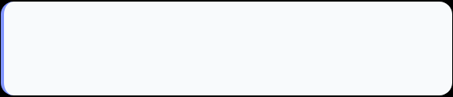



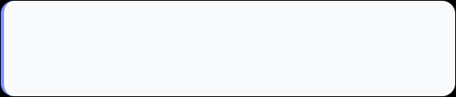





Project Modules
Functional Breakdown of the Architectural Ledger System
01
02
Central Ledger Intelligence
Document Repository
Java SearchService: Ollama embed → Pinecone → Qwen:0.5B answer
Java IngestService: chunk → Ollama embed → Pinecone upsert
03
04
Document Comparison
Vendor Management
Java CompareService: dual Pinecone retrieval → Qwen clause diff
Java Vendor: full CRUD via PostgreSQL JDBC
Sample Contracts
05
Settings
06
Reference library for AI comparison benchmarks
config.properties: Ollama model, Pinecone key, chunk settings
Team: Atharva Abhijeet Mahalkar| Japkeerat Kaur | Prakhar Vishwakarma · Guide: Prof. Suhas Joshi · April 2026
08

Slide 9
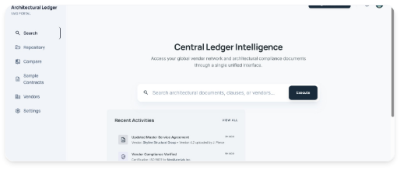
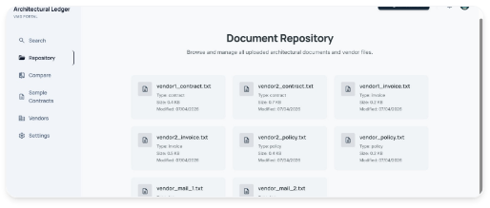
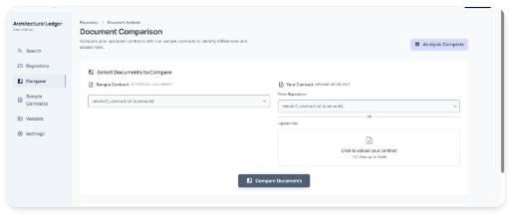
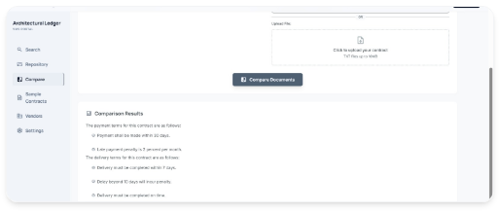
Application Screenshots
1. AI Search — Java SearchService calls Ollama + Pinecone
2. Repository — Java IngestService indexes docs in Pinecone
3. Document Comparison — Java CompareService selects contracts
4. Comparison Results — Qwen:0.5B extracts clauses via Java
Team: Atharva Abhijeet Mahalkar| Japkeerat Kaur | Prakhar Vishwakarma · Guide: Prof. Suhas Joshi · April 2026
09

Slide 10
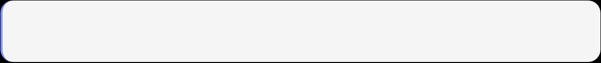




Use Cases
Real-world Scenarios and Workflow Implementations
UC1 — AI Contract Query
Actor: Procurement Manager
Flow:
Query
Java embeds (Ollama)
Pinecone
Qwen:0.5B answers
Result: ✓ Clause answer in 2–5 seconds
UC2 — Contract Risk Compare
Actor: Legal Team
Flow:
Select 2 docs
Java retrieves from Pinecone
Qwen extracts
Result: ✓ Payment, delivery & penalty clauses
UC3 — Compliance Audit
Actor: Compliance Officer
Flow:
Search policy term
Pinecone retrieves all policy docs
Qwen
Result: ✓ Consolidated compliance summary
Team: Atharva Abhijeet Mahalkar| Japkeerat Kaur | Prakhar Vishwakarma · Guide: Prof. Suhas Joshi · April 2026
10

Slide 11




Challenges and Solutions
Overcoming Technical Hurdles in Java-Native RAG Implementation
Qwen:0.5B Context Limit
Reduced chunk size to 400 tokens; top-K=3 for comparison tasks
Parsing Ollama Streamed JSON
Read full HTTP response stream in Java; used org.json to parse result
Pinecone Namespace Isolation
Passed user namespace in every Java upsert & query call in PineconeClient
Pinecone Free Tier Batch Limit
Batched upserts in groups of 100 vectors in Java IngestService
Team: Atharva Abhijeet Mahalkar| Japkeerat Kaur | Prakhar Vishwakarma · Guide: Prof. Suhas Joshi · April 2026
11

Slide 12
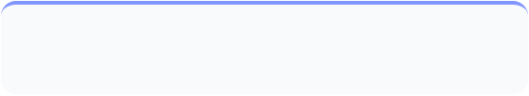

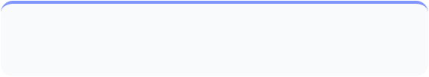

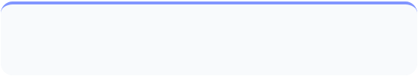

Future Scope
Strategic Roadmap for System Evolution and Enhanced Capabilities
User Auth + Namespaces
PDF & DOCX Parsing
JWT login in Java — per-user Pinecone namespace, isolated search
Apache PDFBox + Apache POI for Java-native document parsing
Automated Risk Scoring
Multi-model Support
Qwen generates 0–100 risk score per contract in Java
Switch Qwen model via config.properties — no code change
Docker / Cloud Deploy
Fine-tuned Qwen
Docker container on AWS/GCP — GPU Ollama + Pinecone prod tier
Fine-tune on legal/procurement text for higher clause accuracy
Team: Atharva Abhijeet Mahalkar| Japkeerat Kaur | Prakhar Vishwakarma · Guide: Prof. Suhas Joshi · April 2026
12

Slide 13





Conclusion
Architectural Ledger is a 100% Java application — the RAG pipeline calls Ollama and Pinecone directly via HTTP, with no Python or external scripting layer required.
Key Achievements:
Pure Java RAG — OllamaClient.java & PineconeClient.java handle all AI HTTP calls
Qwen:0.5B via Ollama — local LLM, CPU-only, ~1.2GB RAM, 2–5s response time
Pinecone — 768-dim cosine vector DB, per-user namespaces, sub-100ms retrieval
PostgreSQL 15 — vendor & document data via JDBC; full CRUD with referential integrity
Thank You · Questions Welcome
Team: Atharva Abhijeet Mahalkar| Japkeerat Kaur | Prakhar Vishwakarma · Guide: Prof. Suhas Joshi · April 2026
13

